Slide 1

CMPS 310
Lecture 3
Chapter 2 Part 1:
Privacy Risks/Principles/Business Social Sectors
Based on slides prepared by Cyndi Chie, Sarah Frye and Sharon Gray.
Fifth edition updated by Timothy Henry

Slide 2

Privacy Risks and Principles
The Business and Social Sectors
The Fourth Amendment, Expectation of Privacy, and Surveillance Technologies
Government Systems
Protecting Privacy: Technology, Markets, Rights, and Laws
Communications

Slide 3
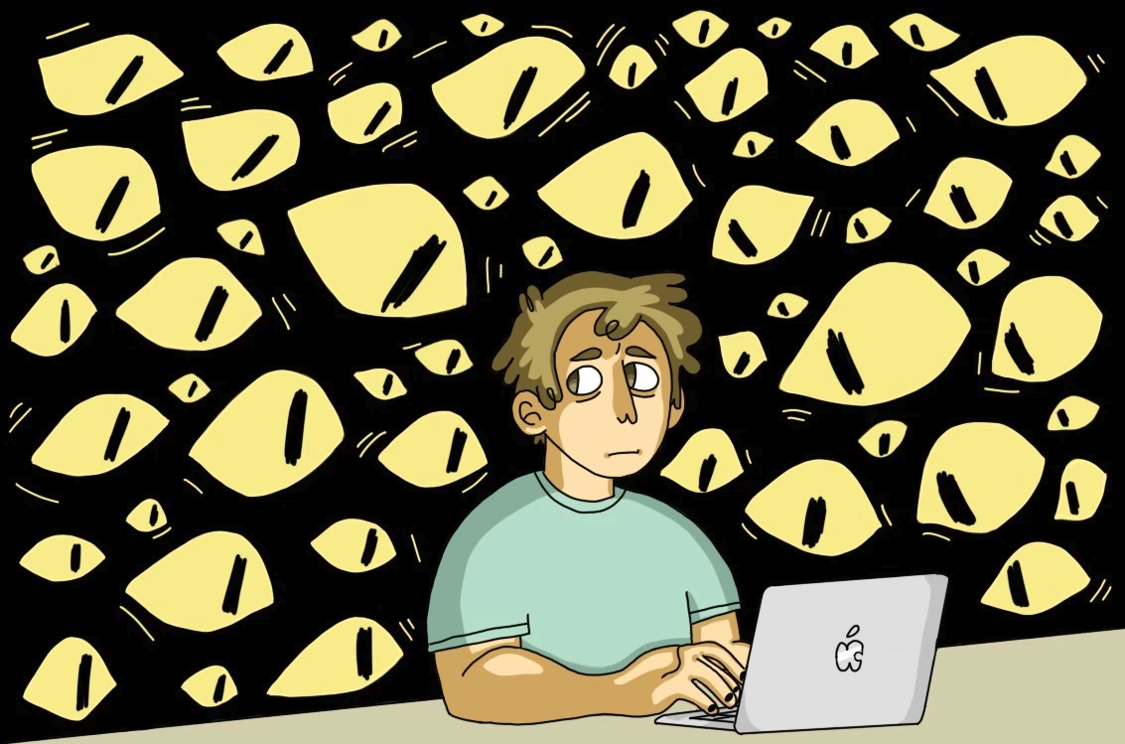
Ever Watching Eyes

Slide 4

Key Aspects of Privacy:
Freedom from intrusion (being left alone)
Control of information about oneself
Freedom from surveillance (from being tracked, followed, watched)
In a small town this is difficult
In NYC it’s easier
Notes:
We cant expect complete privacy.. Our friends even know things about us

Slide 5
Privacy Benefits / Drawbacks
-Keeps thoughts private
-prevents pre-judgement
-Allows for safe self-expression
-Could allow fraud
-Protects the guilty
Notes:
Security: not everyone needs to know that you are not home for example
Consider though that without information, criminals can get away. However, consider without information, you couldn’t get a loan, an apartment, get into school (organizations need to know if they can TRUST YOU)

Slide 6
Privacy threats come in several categories:
Intentional, institutional uses of personal information (law/taxes/etc.)
I.E. banks get access to your spending habits by partnering with stores
Unauthorized use or release by “insiders”
Theft of information
Inadvertent leakage of information
Our own actions
Notes:
The taxes part: what if the IRS searches your DMV records to see who has an expensive car.. Must be more income??
Regarding our own actions, sometimes they are a result of intentional trade-offs (we give up some privacy in order to receive some benefit) and sometimes we are unaware of the risks.

Slide 7

New Technology, New Risks:
Government and private databases
Sophisticated tools for surveillance and data analysis
Vulnerability of data
Example: Some government documents are now easier to access without large time and effort
Notes:
Government documents like divorce and bankruptcy records have long been in public records, but accessing such information took a lot of time and effort.
Tiny cameras are in millions of cellphones.

Slide 8
New Technology, New Risks – Examples:
Search query data
Search engines collect many terabytes of data daily.
Data is analyzed to target advertising and develop new services.
You google about an upcoming video game and then you get ads to preorder it
Who gets to see this data? Why should we care?
Someone searches to write murder mystery novel
Notes:
A terabyte is a trillion bytes.
Search query data can be subpoenaed in court.

Slide 9
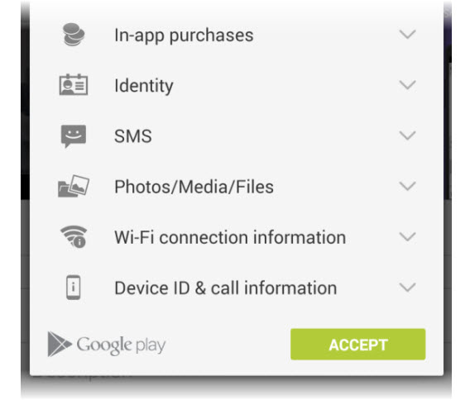
New Technology, New Risks – Examples:
Smartphones
Location apps
Data sometimes stored and sent without user’s knowledge
Notes:
Roughly half the apps in one test sent the smartphone’s ID number or location to other companies (in addition to the one that provided the app).
Various apps copy the user’s contact list to remote servers.
A major bank announced that its free mobile banking app inadvertently stored account numbers and security access codes in a hidden file on the user’s phone. Data in phones are vulnerable to loss, hacking, and misuse. This is a reminder that designers must regularly review and update security design decisions.

Slide 10


VS.
Notes:
Roughly half the apps in one test sent the smartphone’s ID number or location to other companies (in addition to the one that provided the app).
Various apps copy the user’s contact list to remote servers.
A major bank announced that its free mobile banking app inadvertently stored account numbers and security access codes in a hidden file on the user’s phone. Data in phones are vulnerable to loss, hacking, and misuse. This is a reminder that designers must regularly review and update security design decisions.

Slide 11
In 2015 and 2016, Apple Inc. received and objected to or challenged at least 11 orders issued by United States district courts under the All Writs Act of 1789.
In the most famous controversy, Apple refused to create software to unlock the work issued phone of a deceased terrorist shooter
Were they right to do so?
Notes:
Roughly half the apps in one test sent the smartphone’s ID number or location to other companies (in addition to the one that provided the app).
Various apps copy the user’s contact list to remote servers.
A major bank announced that its free mobile banking app inadvertently stored account numbers and security access codes in a hidden file on the user’s phone. Data in phones are vulnerable to loss, hacking, and misuse. This is a reminder that designers must regularly review and update security design decisions.

Slide 12
New Technology, New Risks – Summary of Risks:
Anything we do in cyberspace is recorded.
Huge amounts of data are stored.
People are not aware of collection of data.
Software is complex.
Leaks happen.

Slide 13
New Technology, New Risks – Summary of Risks
(cont.):
A collection of small items can provide a detailed picture.
Re-identification has become much easier due to the quantity of information and power of data search and analysis tools.
An anonymized dataset was released about search queries and researchers were very quick to identify the people in the dataset. It was removed after but then backed up and re-uploaded by others.
If information is on a public Web site, it is available to everyone.
Even if your data is deleted on a website, others may have access
Notes:
Reidentification: just because data is released anonymously (no names) doesn’t mean you can be identified. If the data is even coded with a number for a user, sometimes search queries can be analyzed and you can be identified!

Slide 14
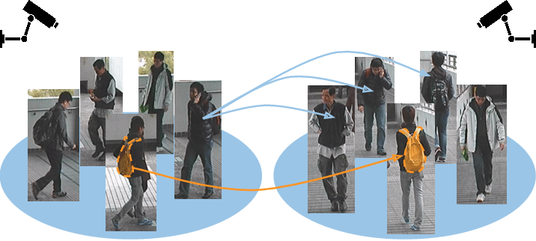

Slide 15
New Technology, New Risks – Summary of Risks
(cont.):
Information on the Internet seems to last forever.
Data collected for one purpose will find other uses.
banks might get access to your purchase history from retailers
Government can request sensitive personal data held by businesses or organizations.
We cannot directly protect information about ourselves. We depend upon businesses and organizations to protect it.

Slide 16
Terminology:
Personal information – any information relating to an individual person.
Informed consent – users being aware of what information is collected and how it is used.
Invisible information gathering - collection of personal information about a user without the user’s knowledge.
Notes:
Personal doesn’t mean just sensitive, it is ANY information about us. So, my name is “personal”

Slide 17
Terminology:
Cookies – Files a Web site stores on a visitor’s computer.
Secondary use – Use of personal information for a purpose other than the purpose for which it was provided.
Data mining – Searching and analyzing masses of data to find patterns and develop new information or knowledge.
Notes:
Within the cookie, the site stores and then uses information about the visitor’s activity. Cookies help companies provide personalized customer service and target advertising to the interests of each visitor.

Slide 18
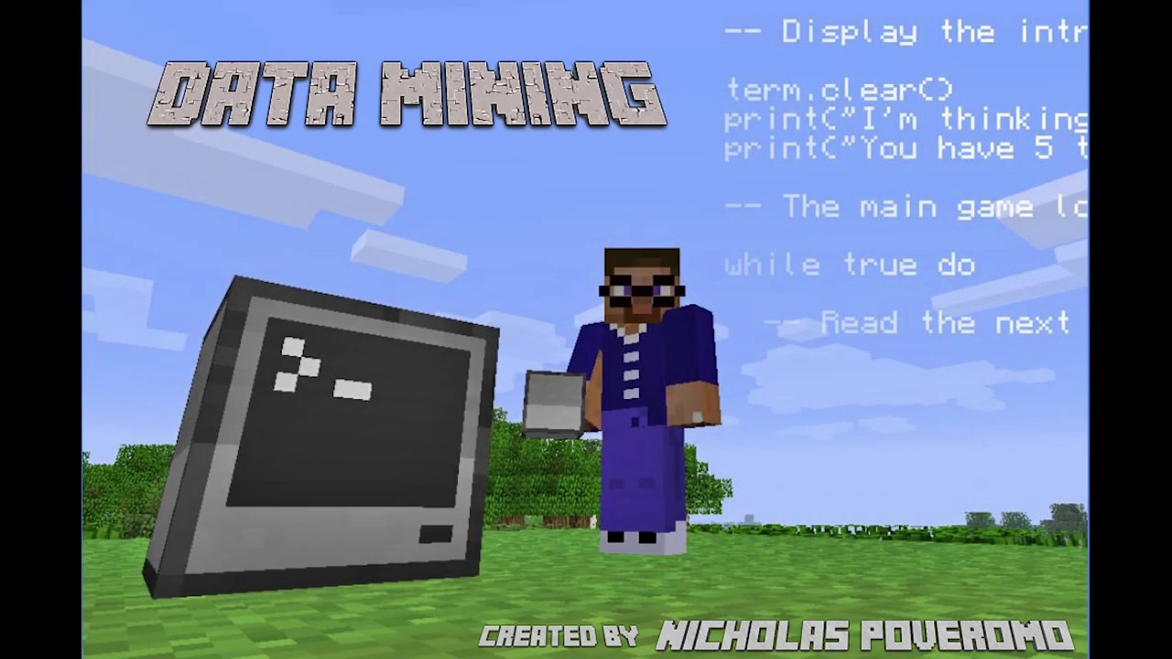

Slide 19
Terminology:
Computer matching – Combining and comparing information from different databases (using social security number, for example) to match records.
Computer profiling – Analyzing data to determine characteristics of people most likely to engage in a certain behavior.

Slide 20


Slide 21
Two common forms for providing informed consent are opt out and opt in:
opt out – Person must request (usually by checking a box) that an organization not use information.
opt in – The collector of the information may use information only if person explicitly permits use (usually by checking a box).
Notes:
Under an opt out policy, more people are likely to be “in”.
Under an opt in policy, more people are likely to be “out”.

Slide 22
Fair information principles
Inform people when you collect information.
Collect only the data needed.
Offer a way for people to opt out.
Keep data only as long as needed.
Maintain accuracy of data.
Protect security of data.
Develop policies for responding to law enforcement requests for data.
Notes:
Business should adhere to this

Slide 23
Thinking Time!
Looking at a type of data that affects YOU!
Your Academic Records!
Questions:
What is your academic record?
Who can access your academic record?
Do you think it can be sold?
Notes:
Give a few minutes
Then put a table on board (what, who, sold?) and see what kind of answers

Slide 24
FERPA
Family Educational Rights and Privacy Act
Student educational records are PROTECTED
Records are:
Personally Identifiable Information
Protected
Educational Records
Grades. GPA.
Automatically protected.
Directory Information
Info that is not considered harmful or invasion of privacy if disclosed (name, address, phone)
School can release but student can forbid

Slide 25
FERPA - Students
Informed Consent
Students can
Request to inspect
Request correction
Restrict release of directory information
FERPA does not apply UNTIL you enroll in a class. If you are denied admission or are admitted and don’t attend, your records are not really under FERPA!
Notes:
Informed Consent.. And you have control of information

Slide 26
FERPA – Who can see records?
STUDENTS!
Faculty/Admins with an ACADEMIC REASON
NO ONE ELSE!
Including Parents!
Thus, don’t worry about your information being sold!
Notes:
Even a student going to work for me is NOT a valid ACADEMIC REASON

Slide 27
Does FERPA ensure following of FIP:
Fair information principles
Inform people when you collect information.
Collect only the data needed.
Offer a way for people to opt out.
Keep data only as long as needed.
Maintain accuracy of data.
Protect security of data.
Develop policies for responding to law enforcement requests for data.
Notes:
In a way, if you know the law
True for the most part
Yep, you can opt out of the directory release
Not sure
YES.. And students can verify this
They do with basic safeguards
Yes.. I think so

Slide 28

Data mining
Targeted ads
If a parent starts researching violent content for writing a story, is it ok if violent ads start appearing on different websites on their family computer?
Can targeted ads encourage unhealthy habits like smoking or frequent gambling?
Is it ethical for stores to send the fact that I bought a case of beer to Facebook who then advertises bars? What about diaper buying and cases of beer (real example)?
Notes:
Companies say targeting reduces the number of ads overall that people will see and provides ads that people are more likely to want. Some targeting is quite reasonable: A clothing site does not display winter parkas on its home page for a shopper from Florida. Some targeting is less obvious.
Is the complex software that personalizes shopping online merely making up for the loss of information that would be available to sellers if we were shopping in person (such as a person’s gender and approximate age)?
Are some people uneasy mainly because they did not realize that their behavior affected what appears on their screen? Do people understand that if they see ads targeted to their interests, someone somewhere is storing information about them?

Slide 29
Informed consent
We should know exactly what data is being collected from our activity.
We should be able to opt out of a website using cookies if we don’t want
“Do Not Track” button in browsers
Notes:
Does a person’s decision to interact with a business or Web site constitute implicit consent to its posted data collection, marketing, and tracking policies?
How clear, obvious, and specific must an information-use policy be?
How often should a site that runs (or allows third parties to run) tracking software remind users?

Slide 30
Paying for consumer information
Example: Shopping cards
+Give discounts!
-Track your purchases!
Notes:
Some businesses offer discounts to shoppers who use cards that enable tracking of their purchases. Lauren Weinstein, founder of Privacy Forum, argues that practice “coerces” less affluent customers into giving up their privacy.

